Slide 1
HL ONLY
TOPIC A4:
MACHINE LEARNING
LESSON A4-5
REGRESSION & K-NN

Slide 2
AGENDA
Warm up
Two kinds of prediction
Linear regression
Slope and intercept
Measuring the fit
More than one predictor
k-nearest neighbours
Choosing k
Scaling and sparsity again
Lab
Close
WHAT U NEED 4 LESSON
Guided Notes
A pen
A calculator
ur hedz

Slide 3
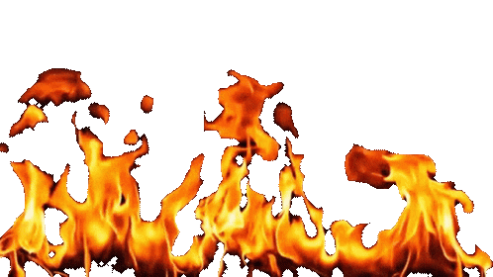
WARM UP QUESTION
(a) State the role of feature selection [1]
(b) State one of the three feature selection strategies [1]
(c) A data set has 4 features. Calculate how many feature subsets exist, including the empty one. [1]
→ Notes Q1 (a), (b), (c)

Slide 4
WARM UP ANSWER
(a) To identify and keep the most informative columns, and delete the rest
(b) Filter, wrapper or embedded
(c) 2⁴ = 16

Slide 5
TWO KINDS OF PREDICTION
Supervised splits into two based on the desired answer from inference
Regression predicts a number on a scale, such as a price, a temperature, a shoe size
  The answer is continuous
Classification predicts which category something belongs to
  Pass or fail, spam or not
  The answer is discrete
Training data still has rows with answers attached either way
We’ll talk about Linear regression to predict numbers and k-NN to pick categories
→ Notes Q2 (a) and (b)

Slide 6
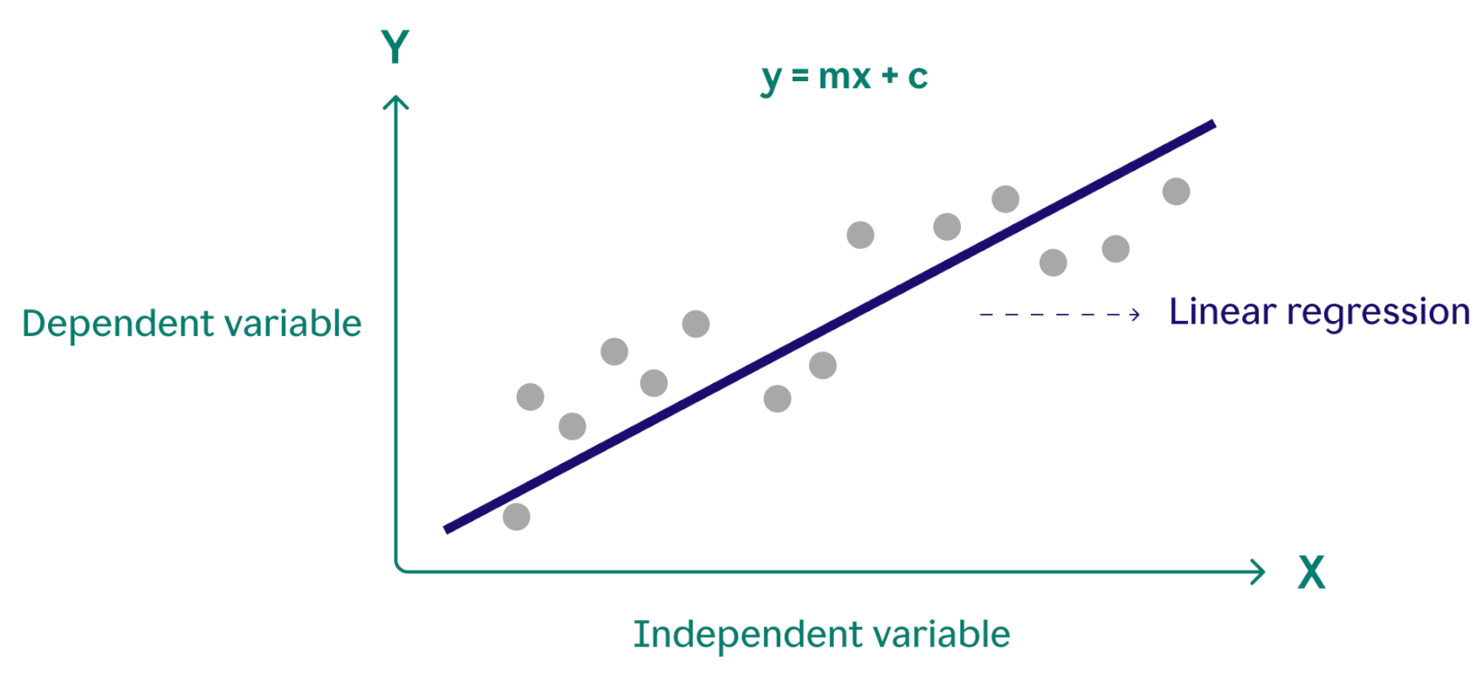
LINEAR REGRESSION
Draw a straight line as close to your data as possible, and then make predictions based on that
The independent variable is what you already know
  It is the ‘predictor’, and it goes on the x axis
The dependent variable is what you are trying to predict
  It is the ‘response’, a.k.a. the ‘inferred’ value and it goes on the y axis
It’s ‘dependent’ because its value depends on ‘independent’ value
The whole model is one equation: y = mx + c
→ Notes Q3 (a) and (b)

Slide 7
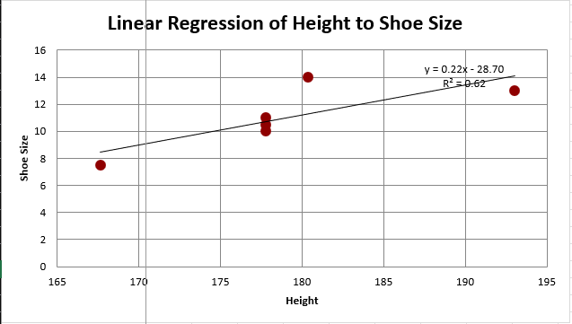
LINEAR REGRESSION
Our data had about 6 students with usable data, so I’ve plotted those here
The best fit line is shoe = 0.22 × height - 28.70
I just calculated this using a spreadsheet

Slide 8
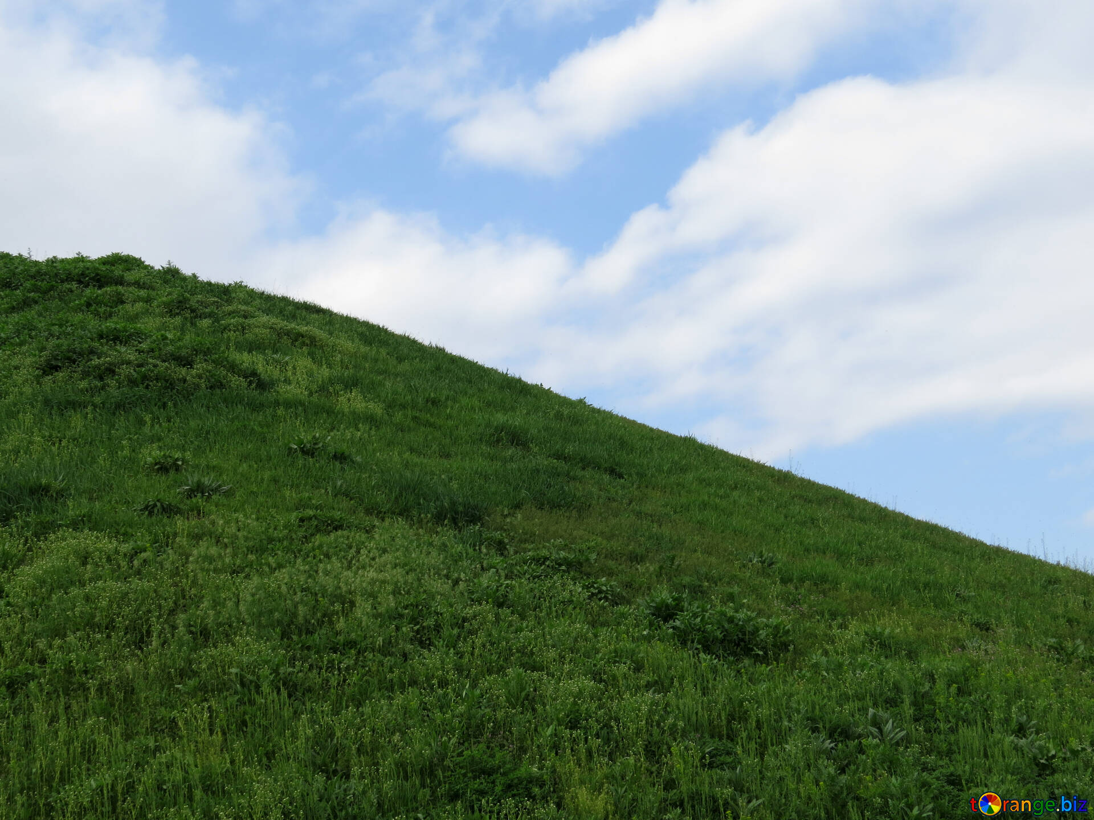
SLOPE AND INTERCEPT
In y = mx + c, m and c
The slope, m, is how much y changes when x goes up by one
Ours is 0.22, so one more centimeter of height is 0.22 more shoe size
A positive slope means they rise together, and a negative slope means one goes up as the other goes down.
The intercept, c, is the predicted y when x is zero
Ours is - 28.70, which would theoretically be the shoe size of a person 0 cm tall
  Of course this doesn’t mean anything, it’s just to set the line up correctly

Slide 9
SLOPE AND INTERCEPT
To predict, substitute. A student is 175 cm tall:
shoe size = 0.22 × 175 - 28.70
shoe = ???
And that’s how using a regression model works, in short
  Put x in, get y out
→ Notes Q4 (a), (b) and (c)

Slide 10
SLOPE AND INTERCEPT
To predict, substitute. A student is 175 cm tall:
shoe size = 0.22 × 175 - 28.70
shoe = 9.8, which I’ll round to 10
And that’s how using a regression model works, in short
  Put x in, get y out
→ Notes Q4 (a), (b) and (c)

Slide 11
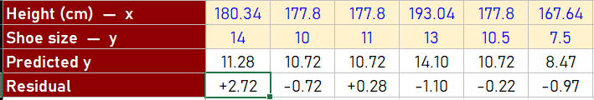
MEASURING THE FIT
Just because we can draw a line doesn’t always mean it’ll be a good way to measure data
A residual is the gap between where the real data point is an where the line is: actual - predicted
Our residuals range from minimal to pretty major
r² summarises all of that in one number between 0 and 1, in this case it’s 0.6162
  It is the share of the variation in y that the line accounts for

Slide 12
MEASURING THE FIT
r² = 1 means every point sits exactly on the line
r² = 0 means the line is no better than ignoring x and guessing the average every time, effectively worthless
Ours is 0.6162, so height accounts for 61.62% of the differences in shoe size here
The remaining amount can be down to other factors we didn’t measure
Note that a high r² does not prove height causes shoe size, it just shows that our line fits well
→ Notes Q5 (a) and (b)

Slide 13
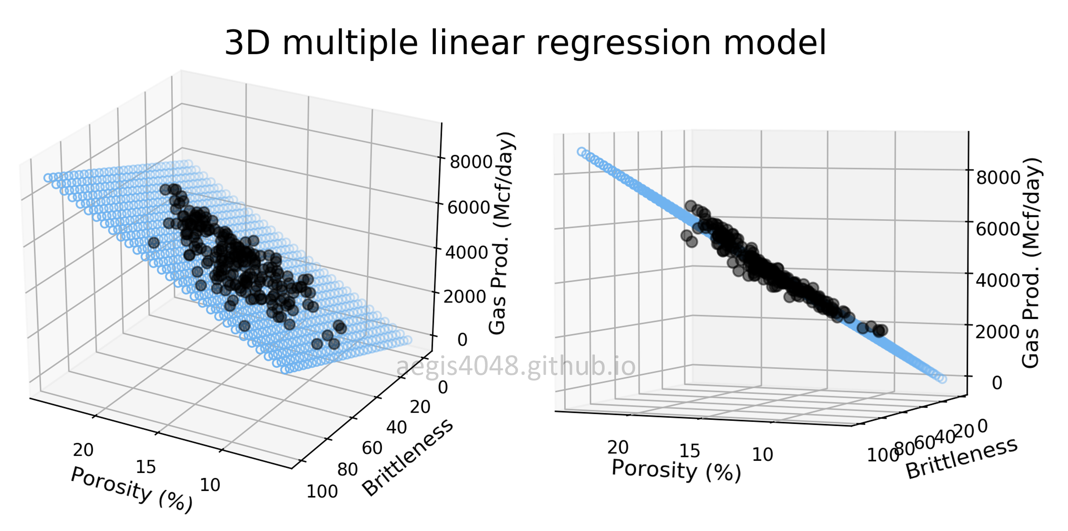
MORE THAN ONE PREDICTOR
One predictor gives a line on a flat graph, but two predictors gives a flat sheet floating in 3D.

Slide 14
MORE THAN ONE PREDICTOR
The equation gets an extra term: y = m₁x₁ + m₂x₂ + c
Each predictor gets its own slope, saying how much y moves with that column while the others are held still
If you add any more, we get into some multi-dimensional tomfoolery, but the general concept still applies
  This is why we called them dimensions last time, and hopefully you can see why adding too many gets confusing lol
  → Notes Q6 (a) and (b)

Slide 15
K-NEAREST NEIGHBOURS
Now for categories and not values
k-NN predicts a category, not a number
Instead of doing training, it just keeps every labelled example it was given.
To classify something new: measure the distance from it to every stored example
Take the k number closest ones and take the label that the most of them have
This is what underlies a ‘people like you watched…’ recommendation on Netflix or smth

Slide 16


K-NEAREST NEIGHBOURS
Assume we have six students, their distance from the school, and how many minutes it takes them to get there
A, B and C walk. D, E and F take the bus
Would a student 1.8 km and 13 minutes away be walking, or taking the bus?
Student | A | B | C | D | E | F
km away | 0.4 | 0.9 | 1.2 | 2.6 | 5.0 | 6.2
minutes | 10 | 14 | 21 | 12 | 26 | 30
travels by | walk | walk | walk | bus | bus | bus

Slide 17
K-NEAREST NEIGHBOURS
Distance (using the distance formula) from the new student to each one, nearest first
  We could normalize these values, but I’m lazy
D is 1.28 away, B is 1.35, A is 3.31, C is 8.02, E is 13.39, F is 17.56
Take the three nearest: D, B and A
They are in the categories bus, walk, and walk respectively
There wasn’t any more of a calculation to it, no model trained here
→ Notes Q7 (a) and (b)

Slide 18
CHOOSING K
If we double check our answers, D was the closest, a bus rider
So k = 1 answers bus, and k = 3 answers walk, even though the dataset we used is the same
k = 1 trusts one data point completely, so one mislabelled example is enough to be wrong
A large k smooths out that noise, but could start including data that isn’t similar at all

Slide 19
CHOOSING K
Keep k odd when there are two categories, that way there’s no tie
There is no formula for the right k
  You try several and use the best option you found
→ Notes Q8 (a) and (b)

Slide 20
SCALING AND SPARSITY AGAIN
Columns on different scales: the biggest raw numbers decide the distance alone – like age against salary
Too many columns: everything is equally far from everything, so nearest stops meaning similar - dimensionality
Cleaning and feature selection are incredibly important because k-NN relies on them
Linear regression is less particular, which might make it preferable to you
→ Notes Q9

Slide 21
LAB
→ Notes Q10 and Q11
Q10 A line of best fit is given as y = 1.4x + 12, where x is hours revised and y is test score. Interpret the slope and the intercept, and predict the score for 6 hours. [4]
Q11 Explain why k-NN gives unreliable results when one feature is measured in a much larger unit than the others. [2]

Slide 22

VOCABULARY TO REMEMBER
Regression
Classification
Continuous
Discrete
Independent variable
Dependent variable
Slope
Intercept
Residual
r²
k-nearest neighbours
k
Hyperparameter
Collaborative filtering

